Slide 1
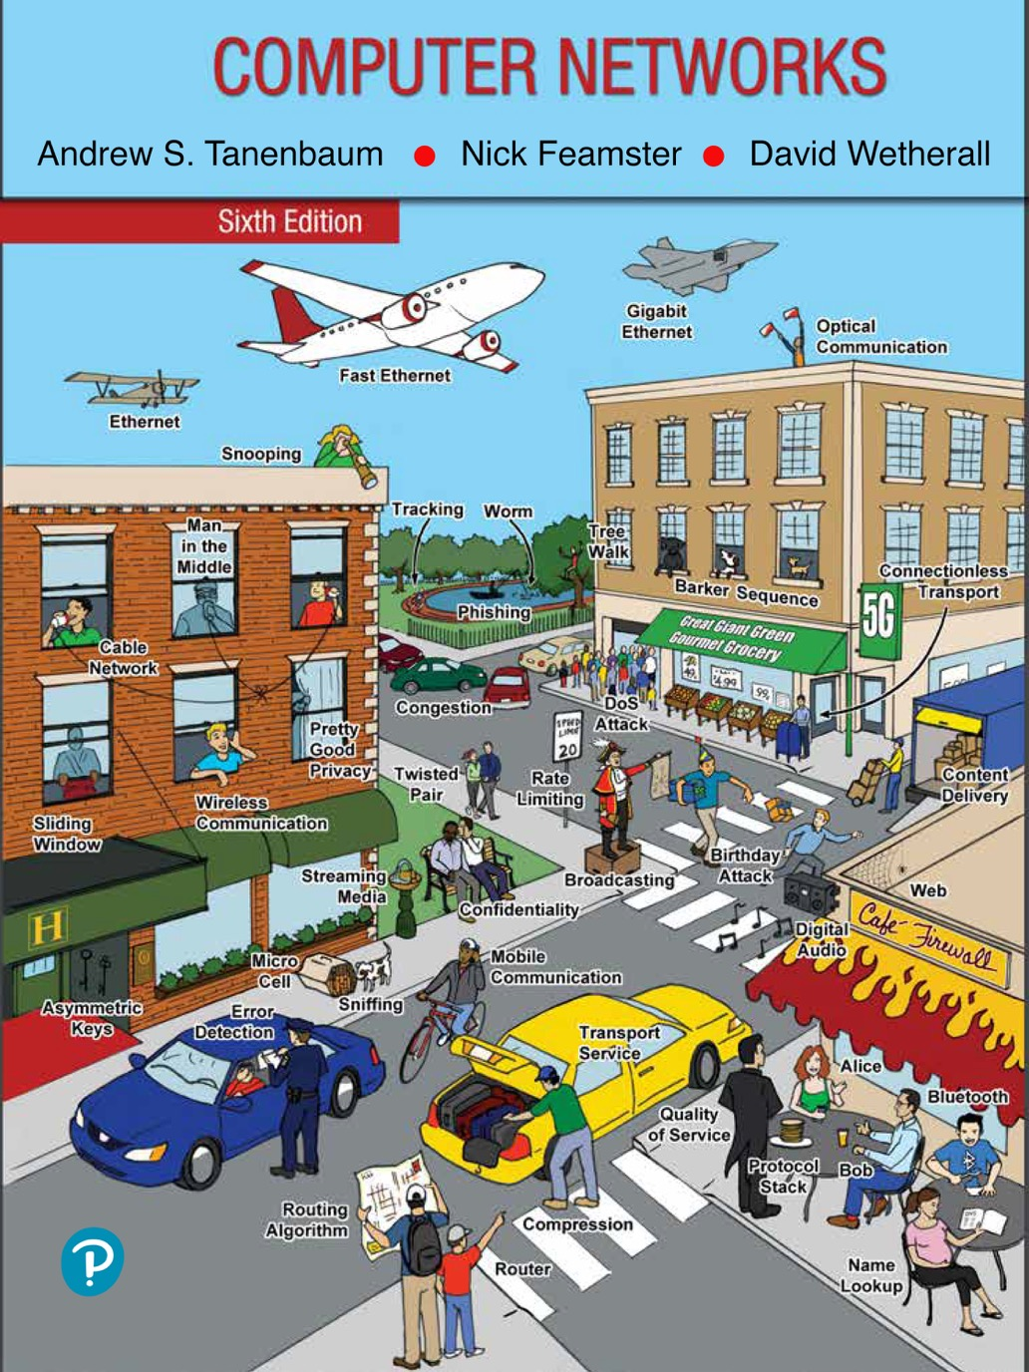
Chapter 6
The Transport Layer

Slide 2
The Transport Service
Services provided to the upper layers
Transport service primitives
Berkeley sockets
Example of socket programming: an Internet file server

Slide 3
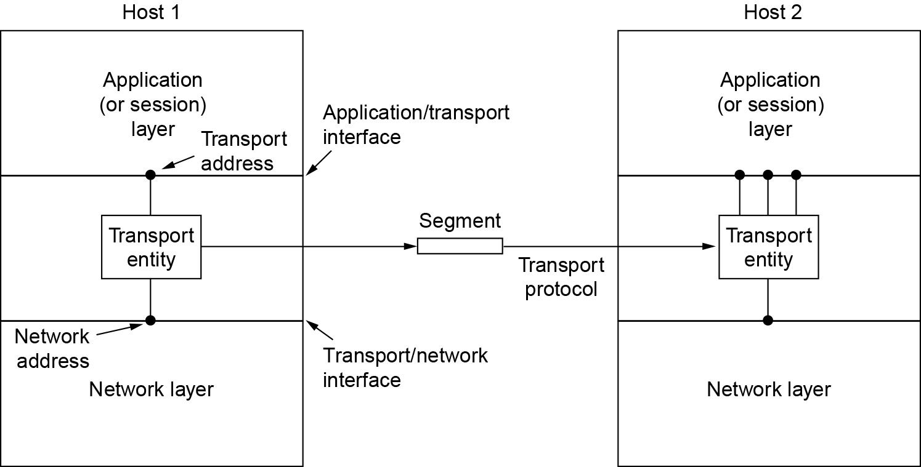
Services Provided to the Upper Layers
The network, transport, and application layers

Slide 4
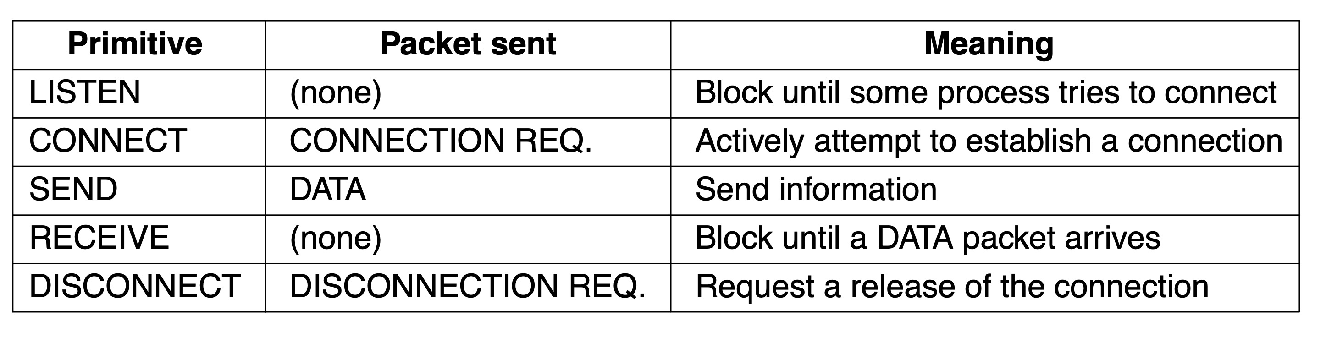
Transport Service Primitives (1 of 2)
The primitives for a simple transport service

Slide 5
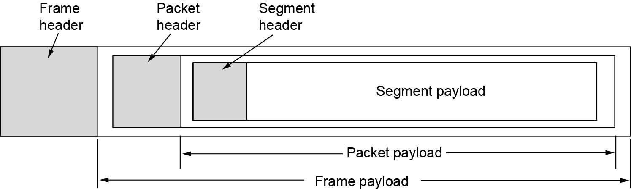
Transport Service Primitives (2 of 2)
Nesting of segments, packets, and frames

Slide 6
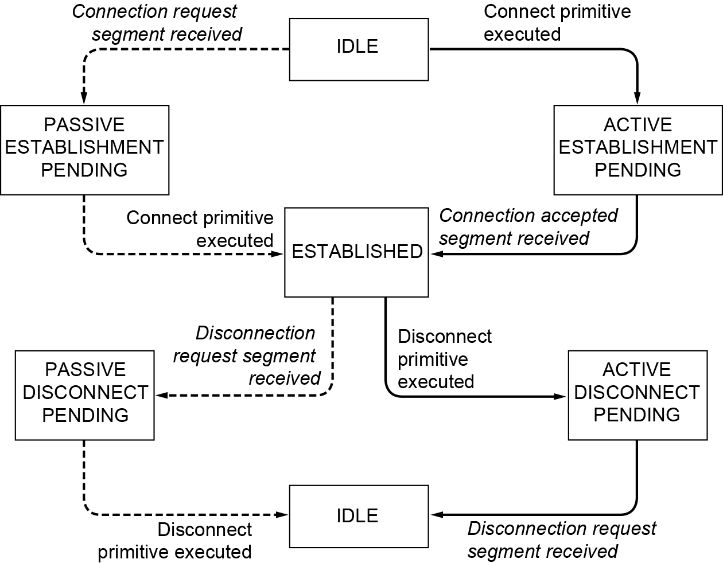
Berkeley Sockets (1 of 2)
A state diagram for a simple connection management scheme. Transitions labeled in italics are caused by packet arrivals. The solid lines show the client’s state sequence. The dashed lines show the server’s state sequence.

Slide 7
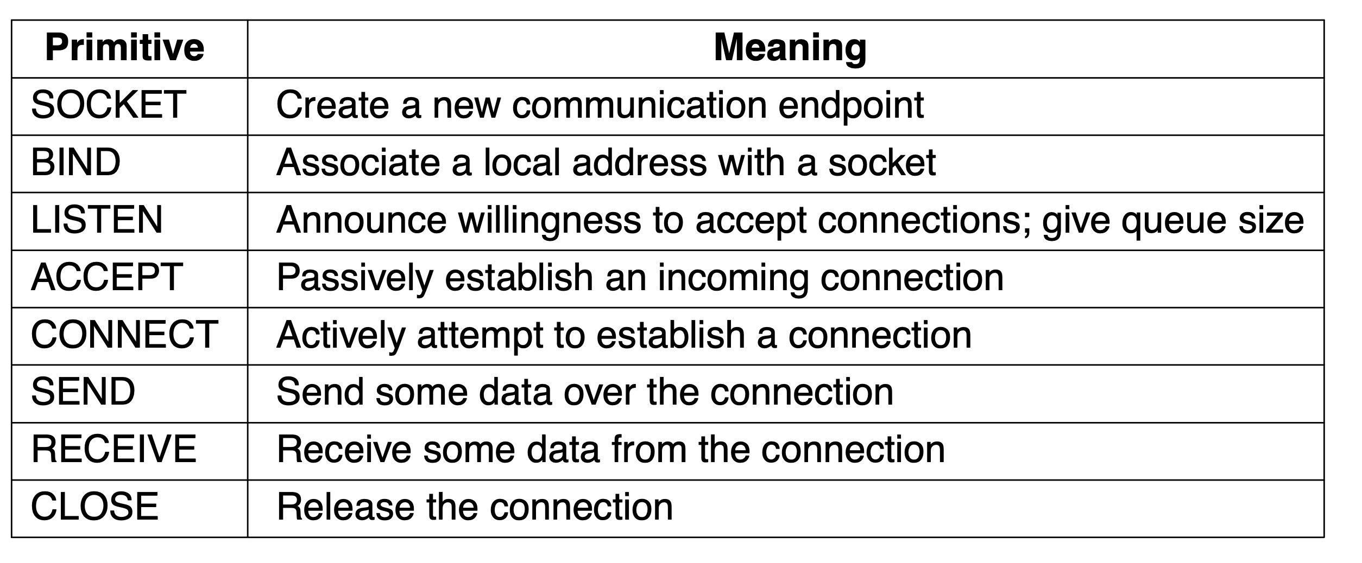
Berkeley Sockets (2 of 2)
The socket primitives for TCP

Slide 8
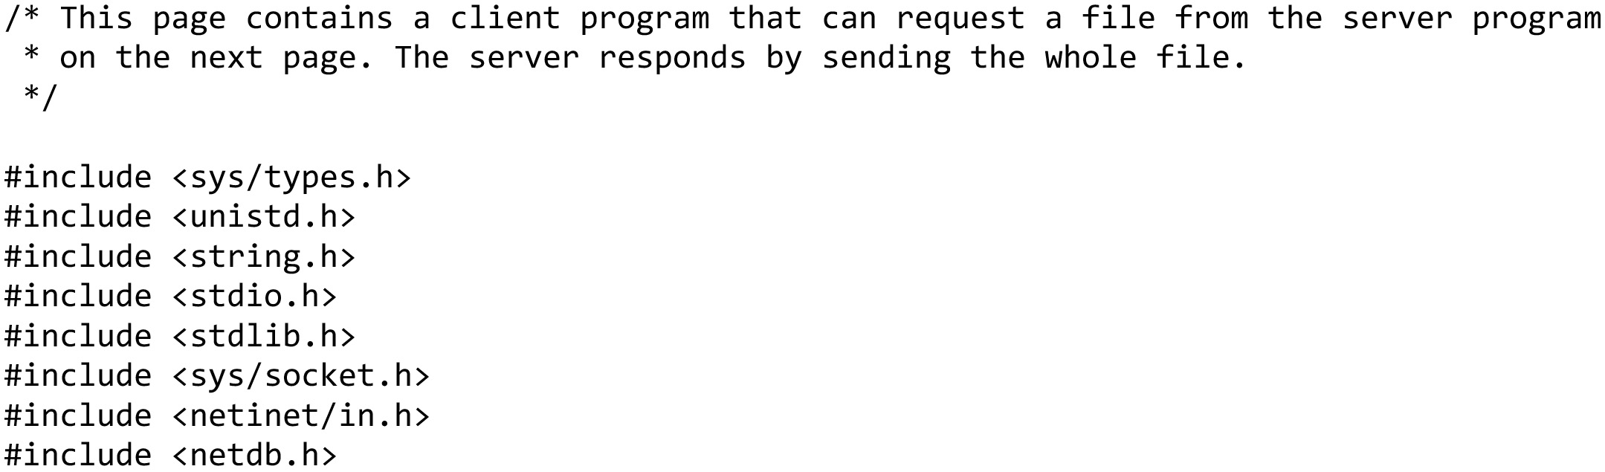
An Example of Socket Programming: An Internet File Server (1 of 10)
Client code using sockets … continued on the next slide

Slide 9
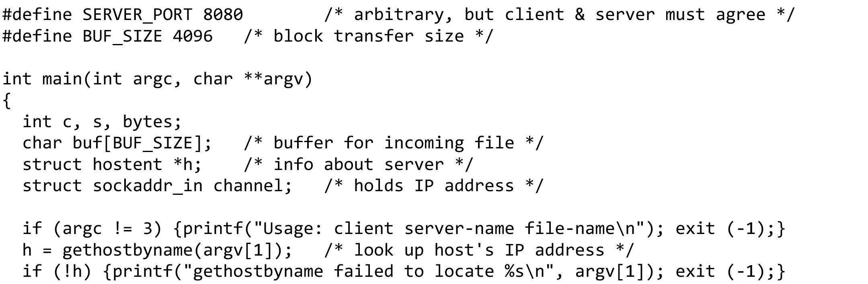
An Example of Socket Programming: An Internet File Server (2 of 10)
Client code using sockets … continued on the next slide

Slide 10
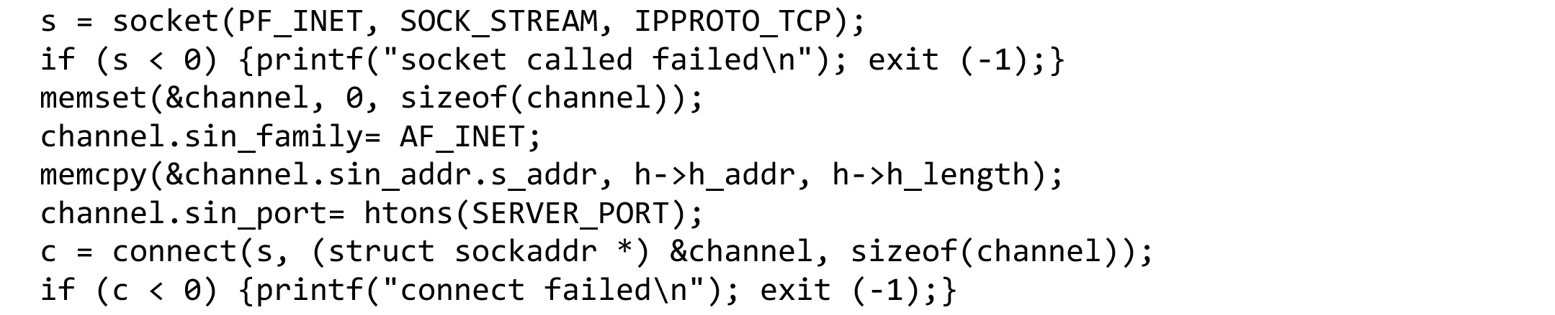
An Example of Socket Programming: An Internet File Server (3 of 10)
Client code using sockets … continued on the next slide

Slide 11
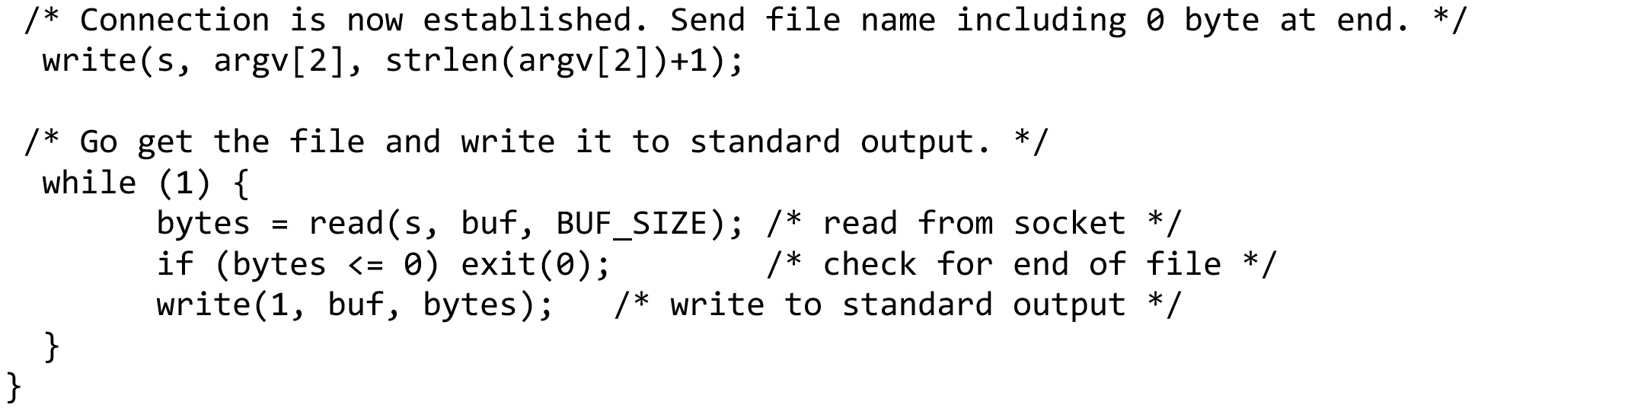
An Example of Socket Programming: An Internet File Server (4 of 10)
Client code using sockets (end of client code)

Slide 12
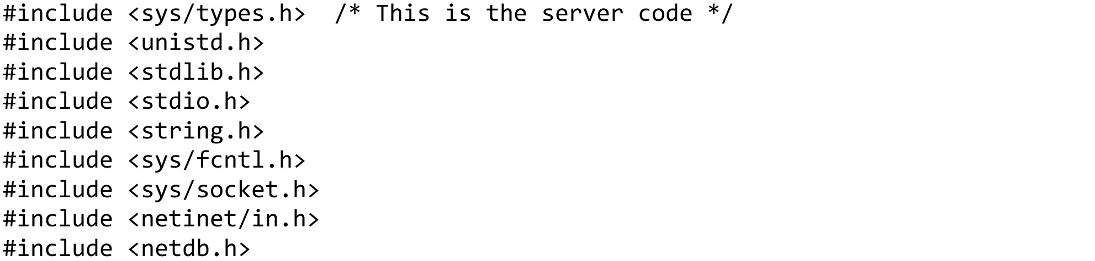
An Example of Socket Programming: An Internet File Server (5 of 10)
Server code using sockets … continued on the next slide

Slide 13
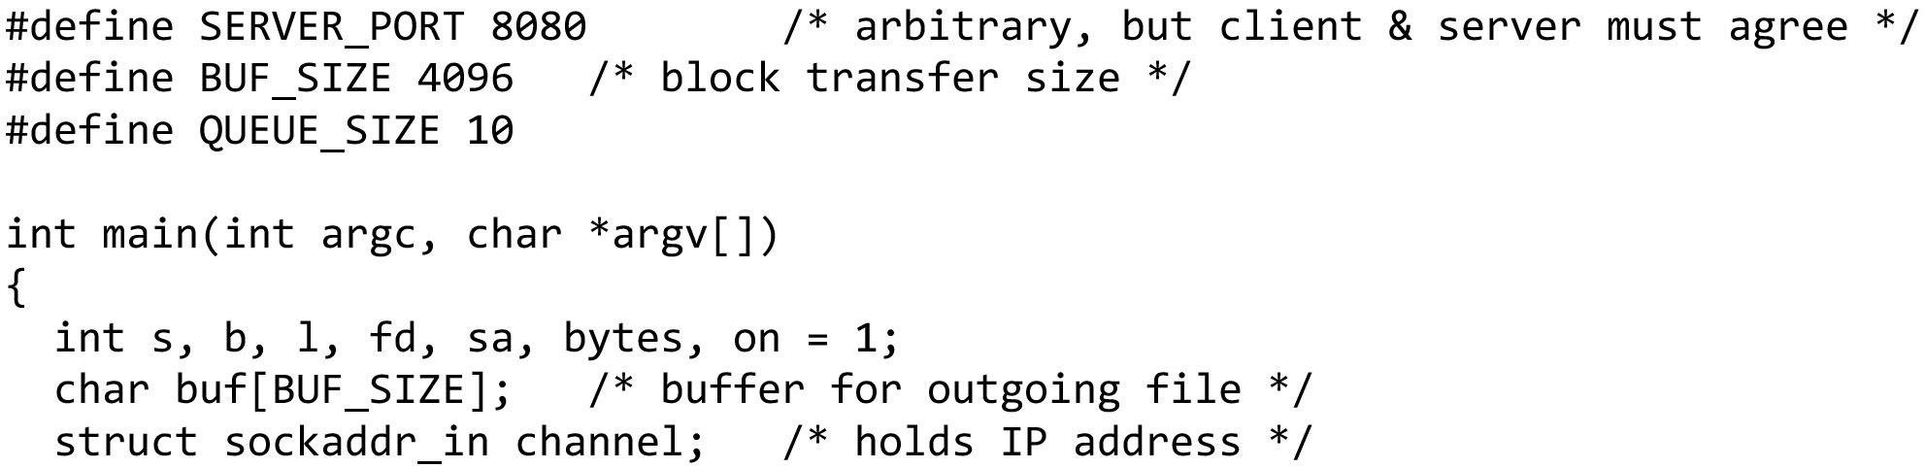
An Example of Socket Programming: An Internet File Server (6 of 10)
Server code using sockets … continued on the next slide

Slide 14
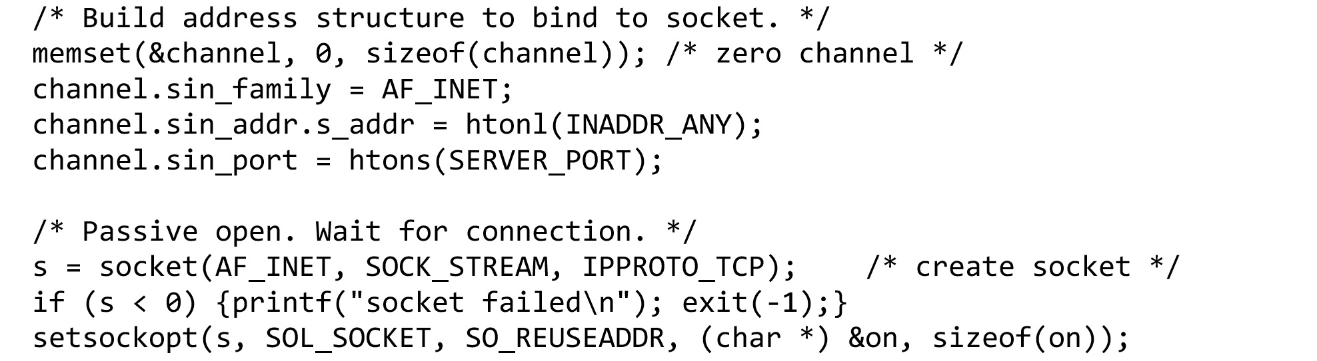
An Example of Socket Programming: An Internet File Server (7 of 10)
Server code using sockets … continued on the next slide

Slide 15
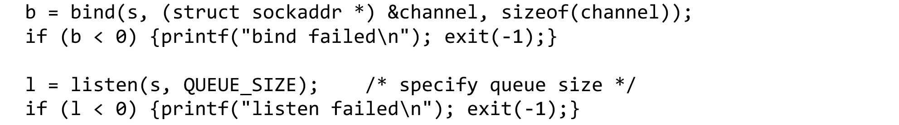
An Example of Socket Programming: An Internet File Server (8 of 10)
Server code using sockets … continued on the next slide

Slide 16
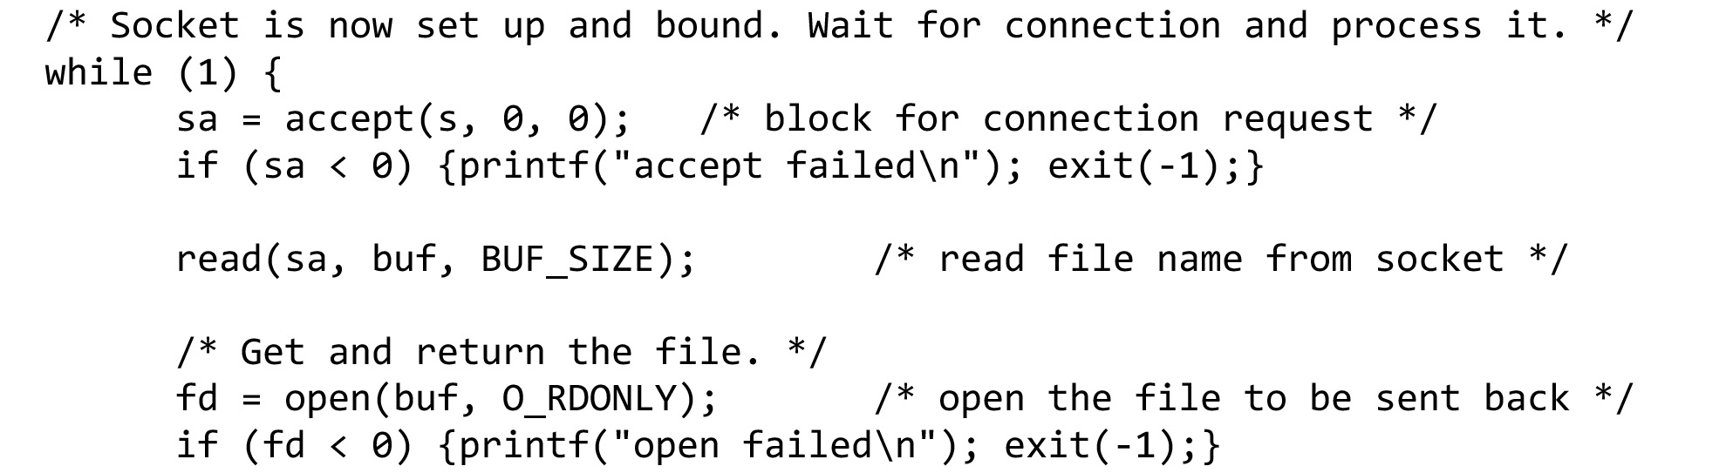
An Example of Socket Programming: An Internet File Server (9 of 10)
Server code using sockets … continued on the next slide

Slide 17
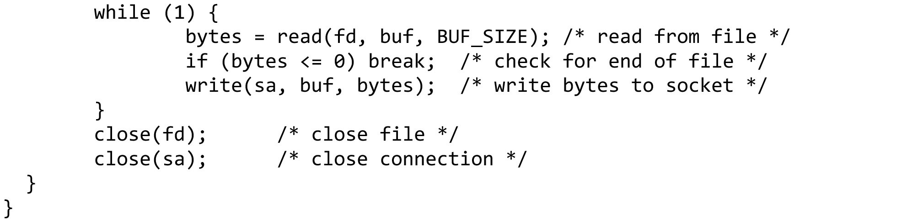
An Example of Socket Programming: An Internet File Server (10 of 10)
Server code using sockets (end of code)

Slide 18
Elements of Transport Protocols (1 of 2)
Addressing
Connection establishment
Problem: Delayed and duplicate packets
Solution: Three-way handshake
Connection release
Error control and flow control
Multiplexing
Crash recovery

Slide 19
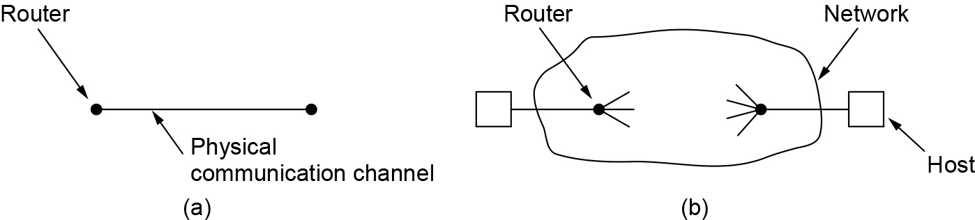
Elements of Transport Protocols (2 of 2)
(a) Environment of the data link layer. (b) Environment of the transport layer.

Slide 20
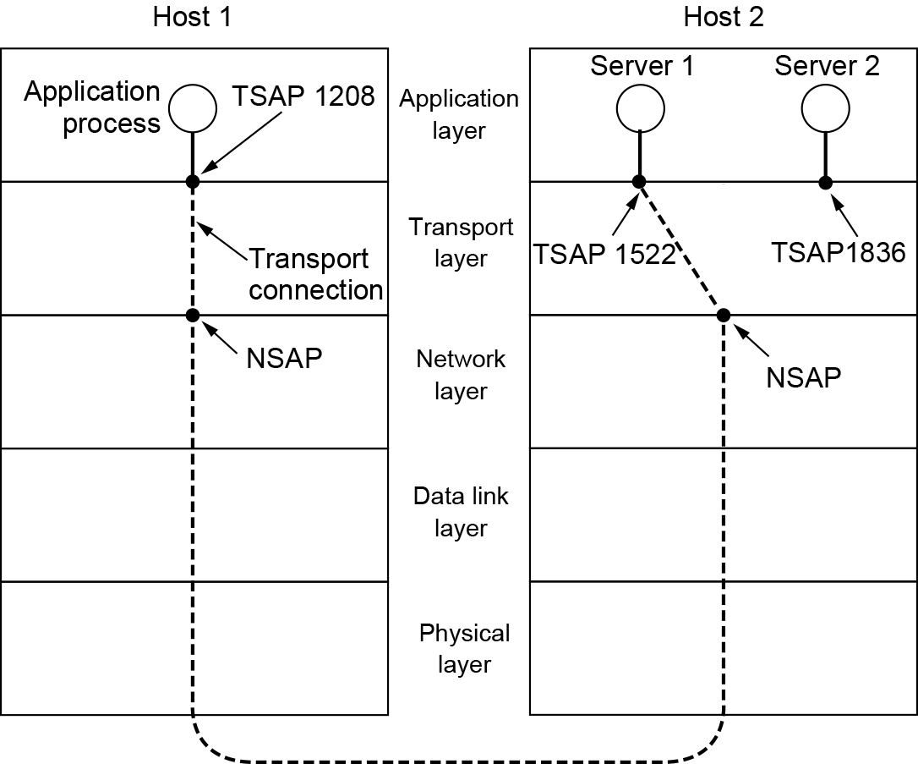
Addressing (1 of 2)
TSAPs, NSAPs, and transport connections

Slide 21
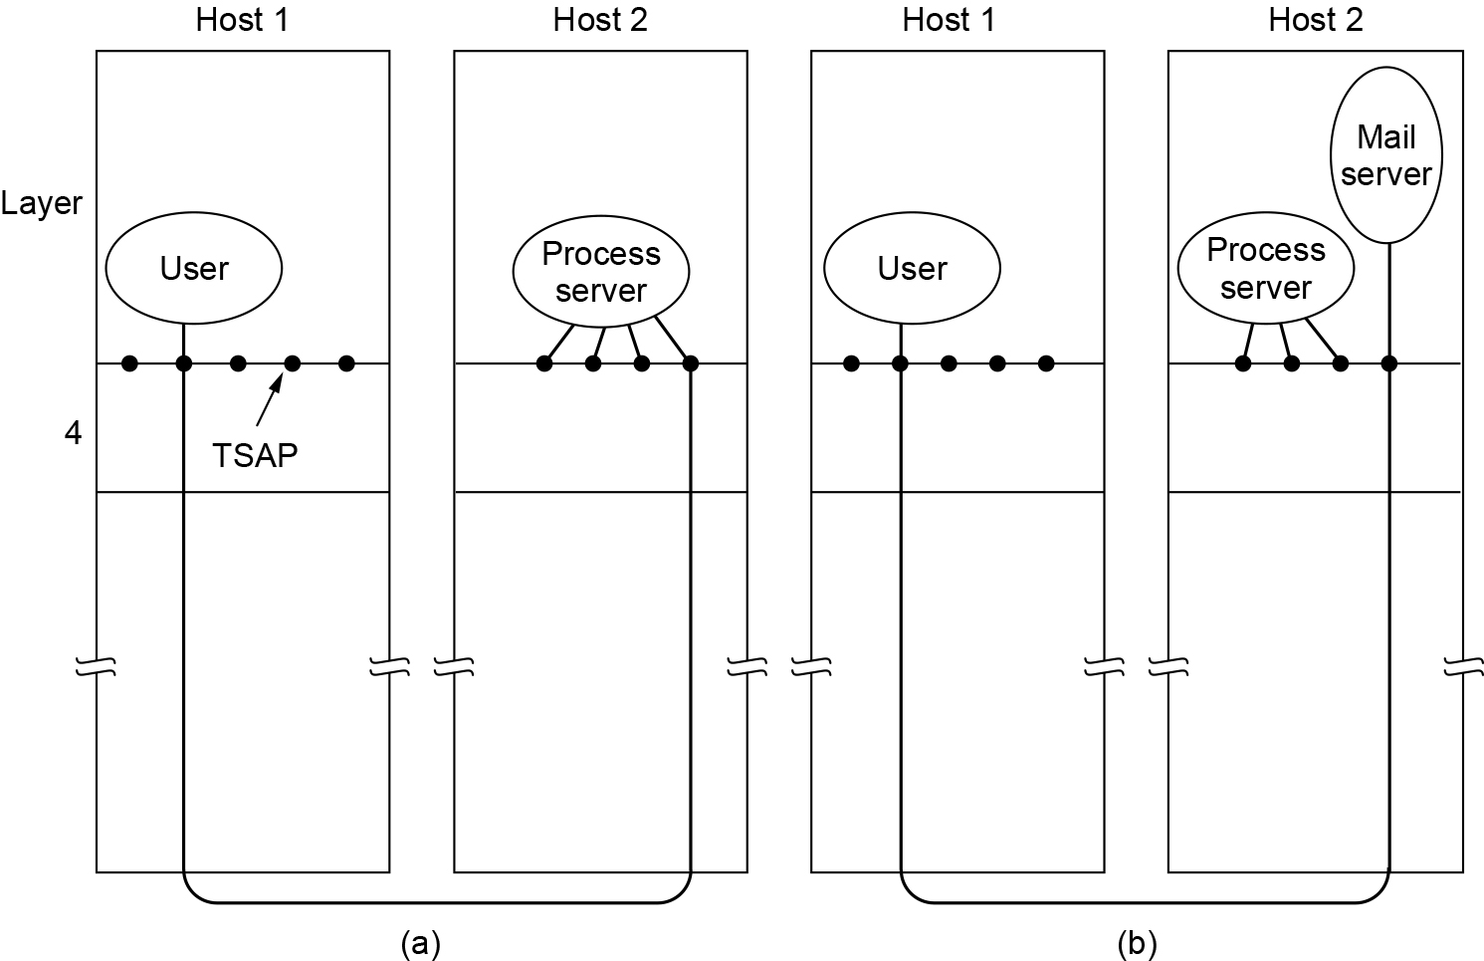
Addressing (2 of 2)
How a user process in host 1 establishes a connection with a mail server in host 2 via a process server

Slide 22
Connection Establishment (1 of 3)
Techniques for restricting packet lifetime
Restricted network design
Putting a hop counter in each packet
Timestamping each packet

Slide 23
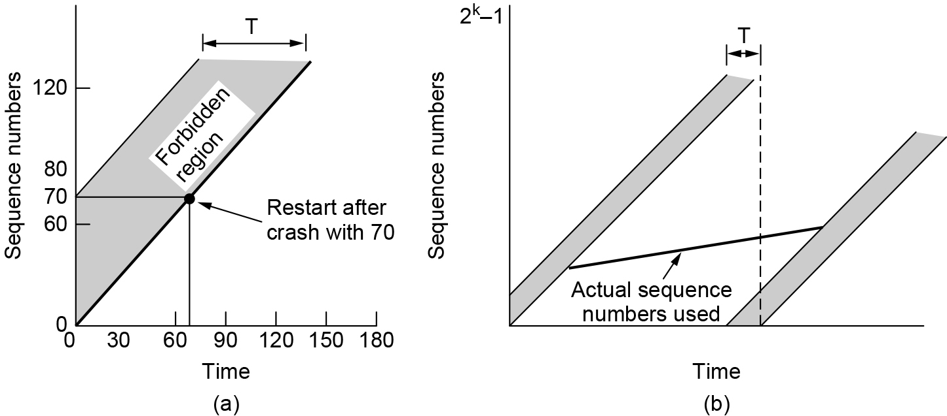
Connection Establishment (2 of 3)
(a) Segments may not enter the forbidden region. (b) The resynchronization problem.

Slide 24
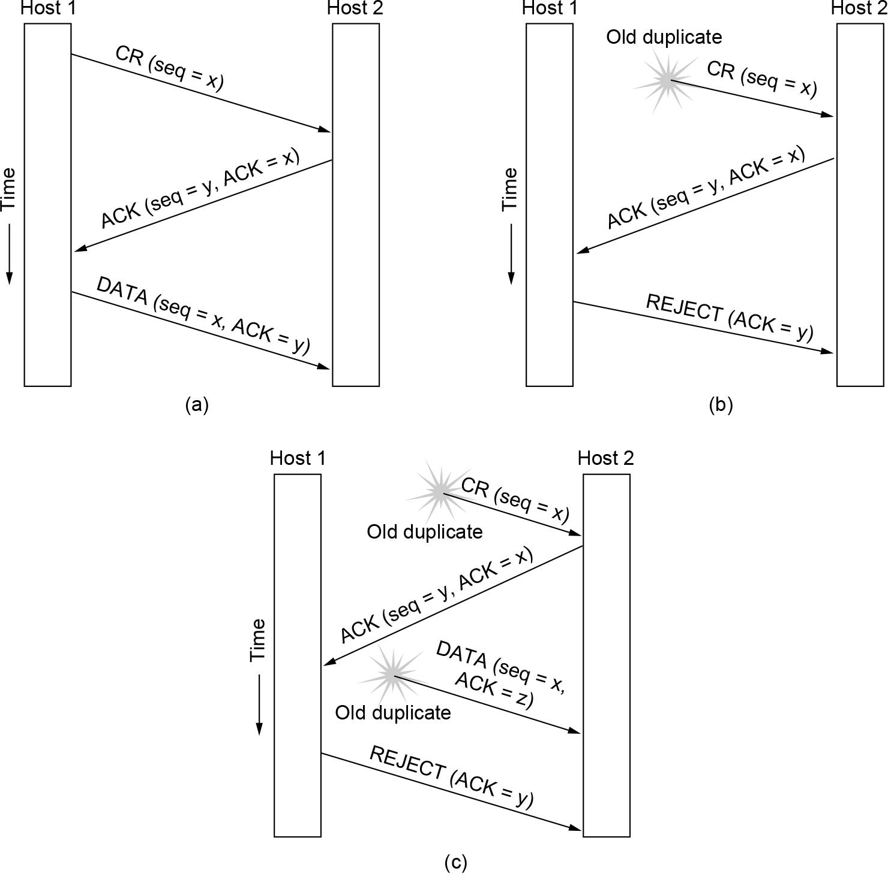
Connection Establishment (3 of 3)
Three protocol scenarios for establishing a connection using a three-way handshake. CR denotes CONNECTION REQUEST. (a) Normal operation. (b) Old duplicate CONNECTION REQUEST appearing out of nowhere. (c) Duplicate CONNECTION REQUEST and duplicate ACK.

Slide 25
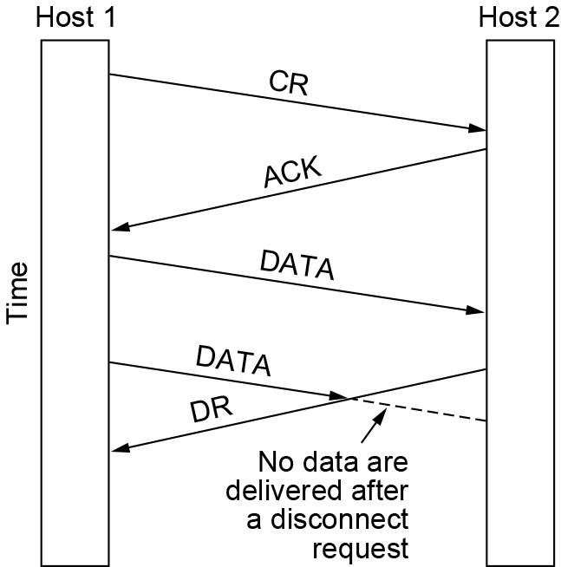
Connection Release (1 of 3)
Abrupt disconnection with loss of data

Slide 26
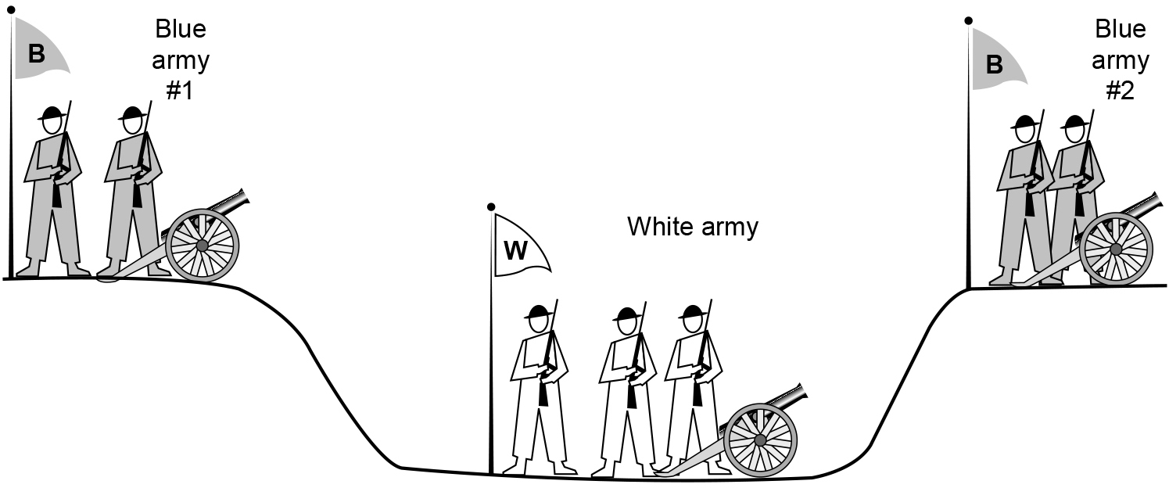
Connection Release (2 of 3)
The two-army problem

Slide 27
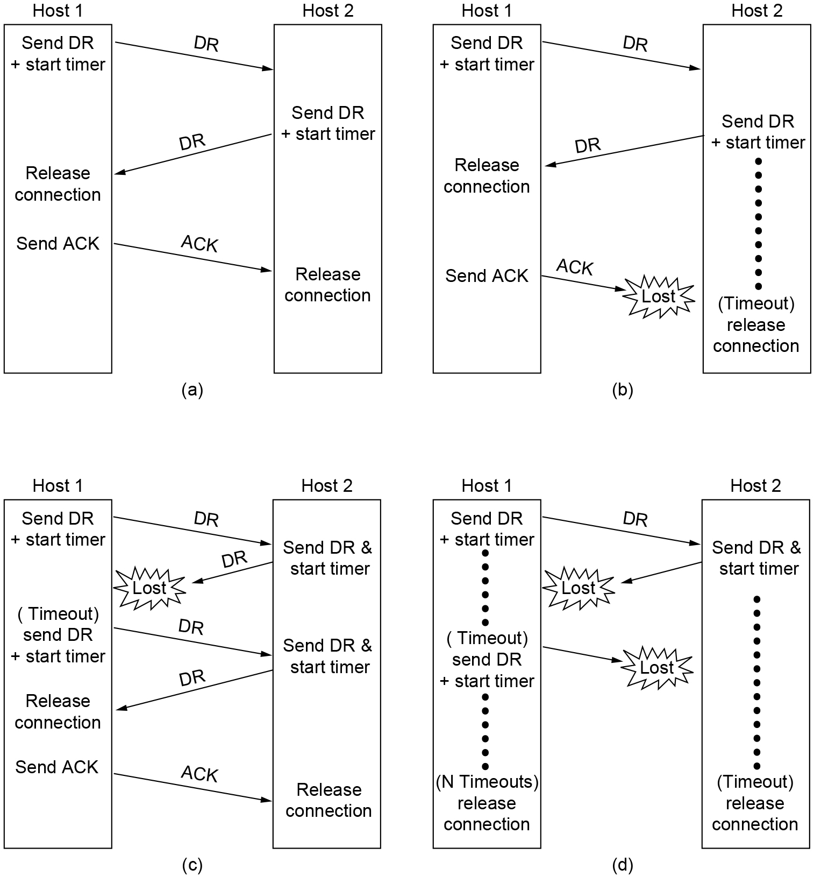
Connection Release (3 of 3)
Four protocol scenarios for releasing a connection. (a) Normal case of three-way handshake. (b) Final ACK lost. (c) Response lost. (d) Response lost and subsequent DRs lost.

Slide 28
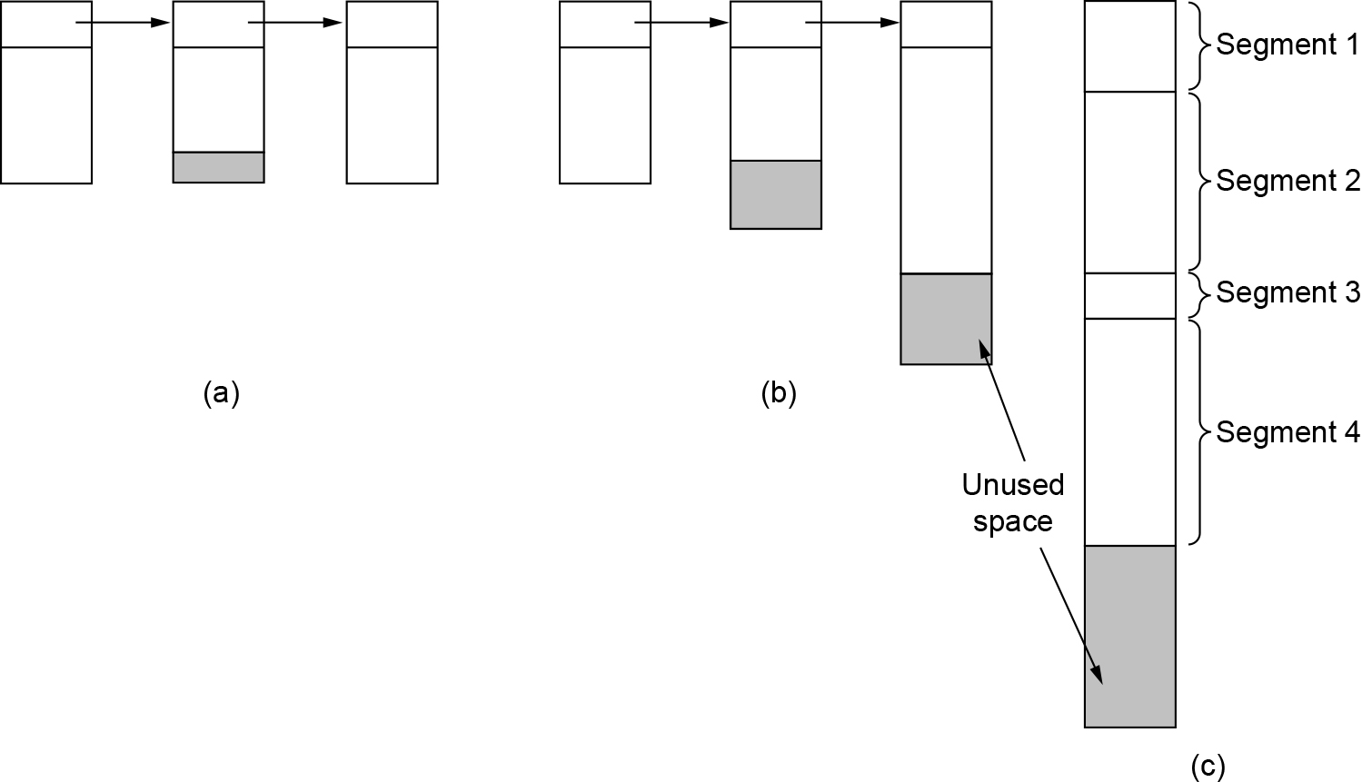
Error Control and Flow Control (1 of 2)
(a) Chained fixed-size buffers. (b) Chained variable-sized buffers. (c) One large circular buffer per connection.

Slide 29
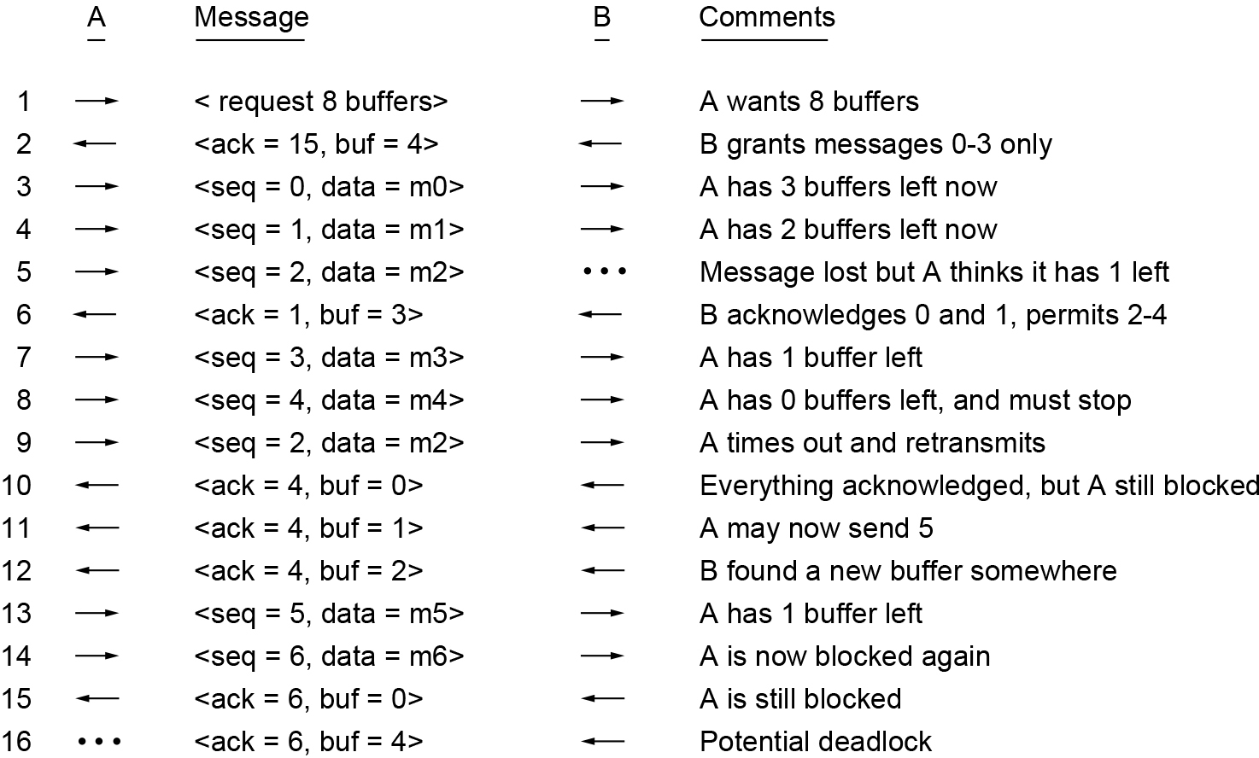
Error Control and Flow Control (2 of 2)
Dynamic buffer allocation. The arrows show the direction of transmission. An ellipsis (...) indicates a lost segment.

Slide 30
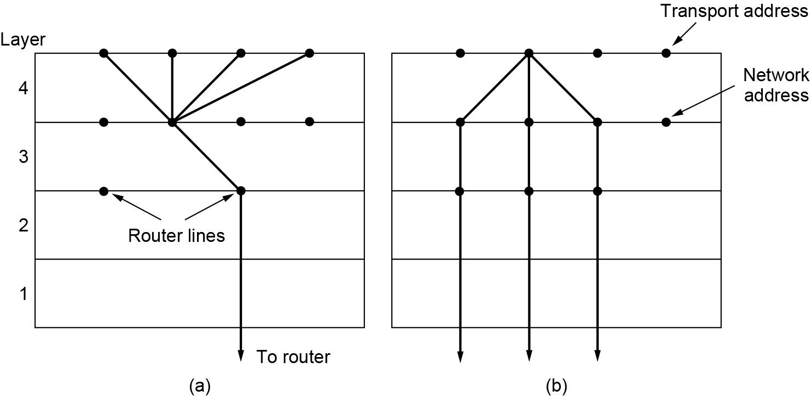
Multiplexing
(a) Multiplexing. (b) Inverse multiplexing.

Slide 31
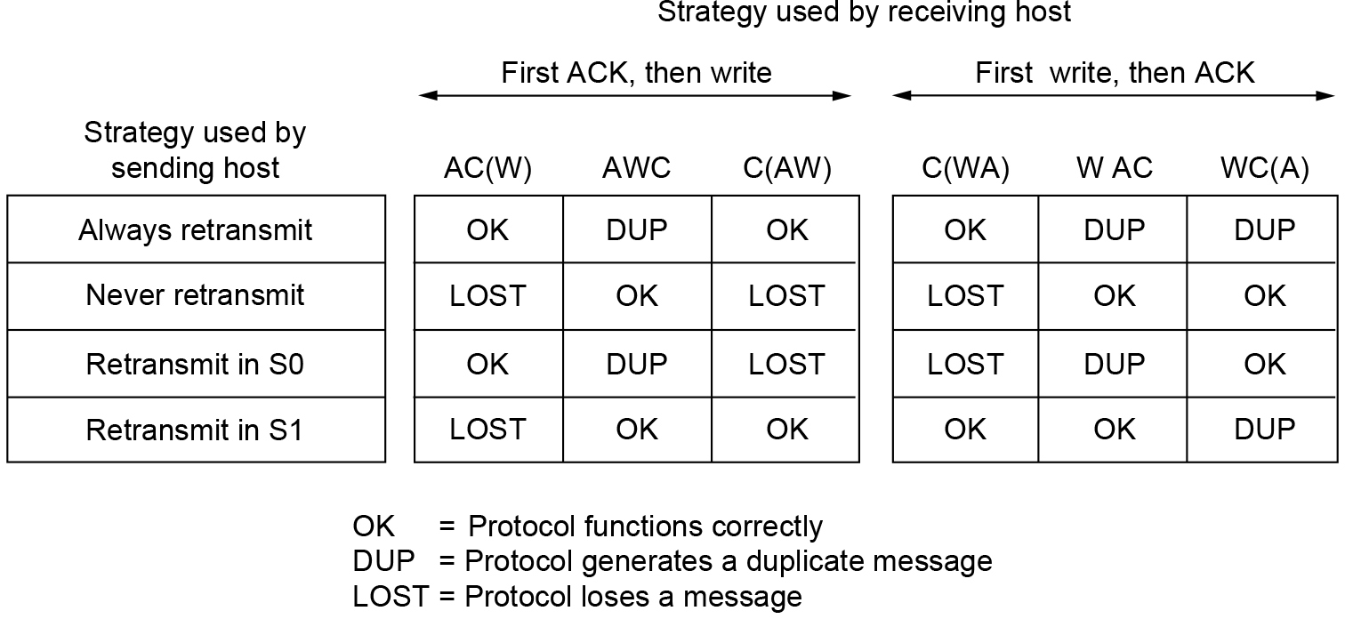
Crash Recovery
Different combinations of client and server strategies

Slide 32
Congestion Control
Desirable bandwidth allocation
Efficiency and power
Max-min fairness
Convergence
Regulating the sending rate
Wireless Issues

Slide 33
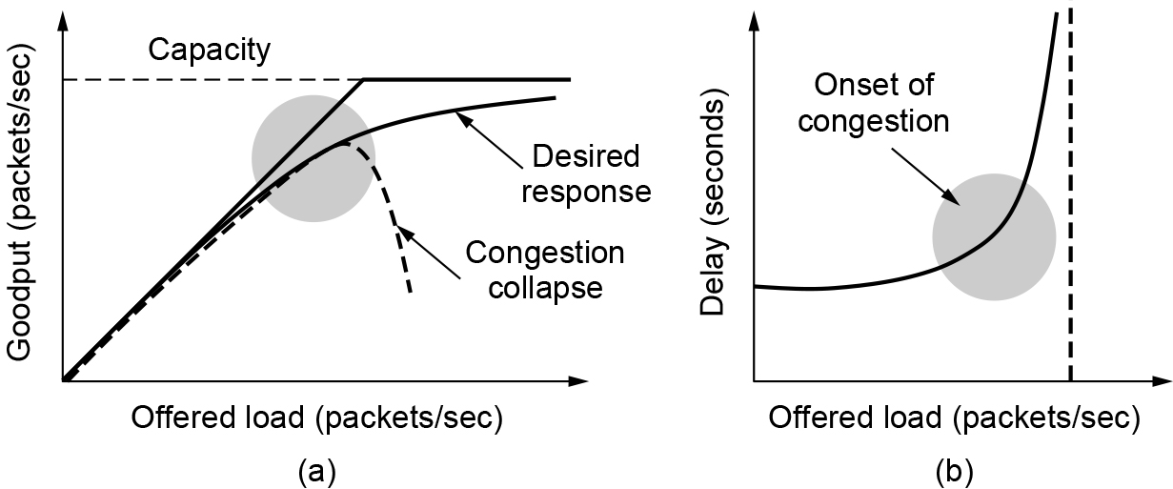
Desirable Bandwidth Allocation (1 of 3)
(a) Goodput and (b) delay as a function of offered load.

Slide 34
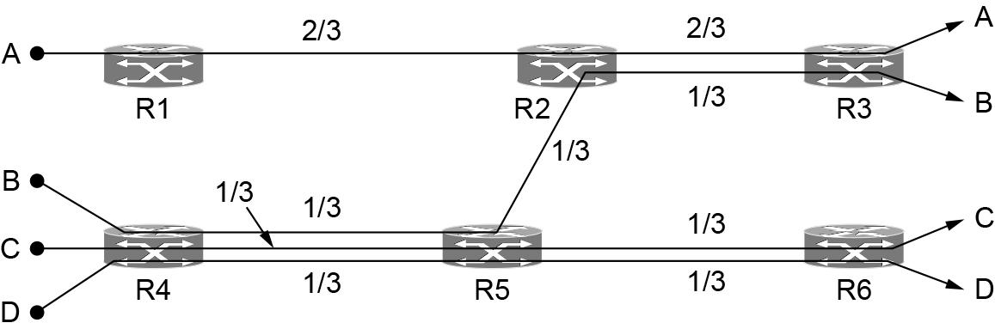
Desirable Bandwidth Allocation (2 of 3)
Max-min bandwidth allocation for four flows

Slide 35
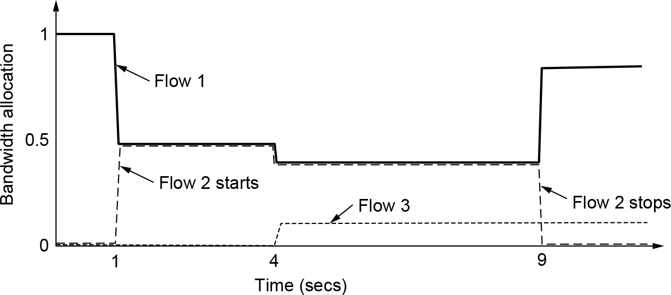
Desirable Bandwidth Allocation (3 of 3)
Changing bandwidth allocation over time

Slide 36
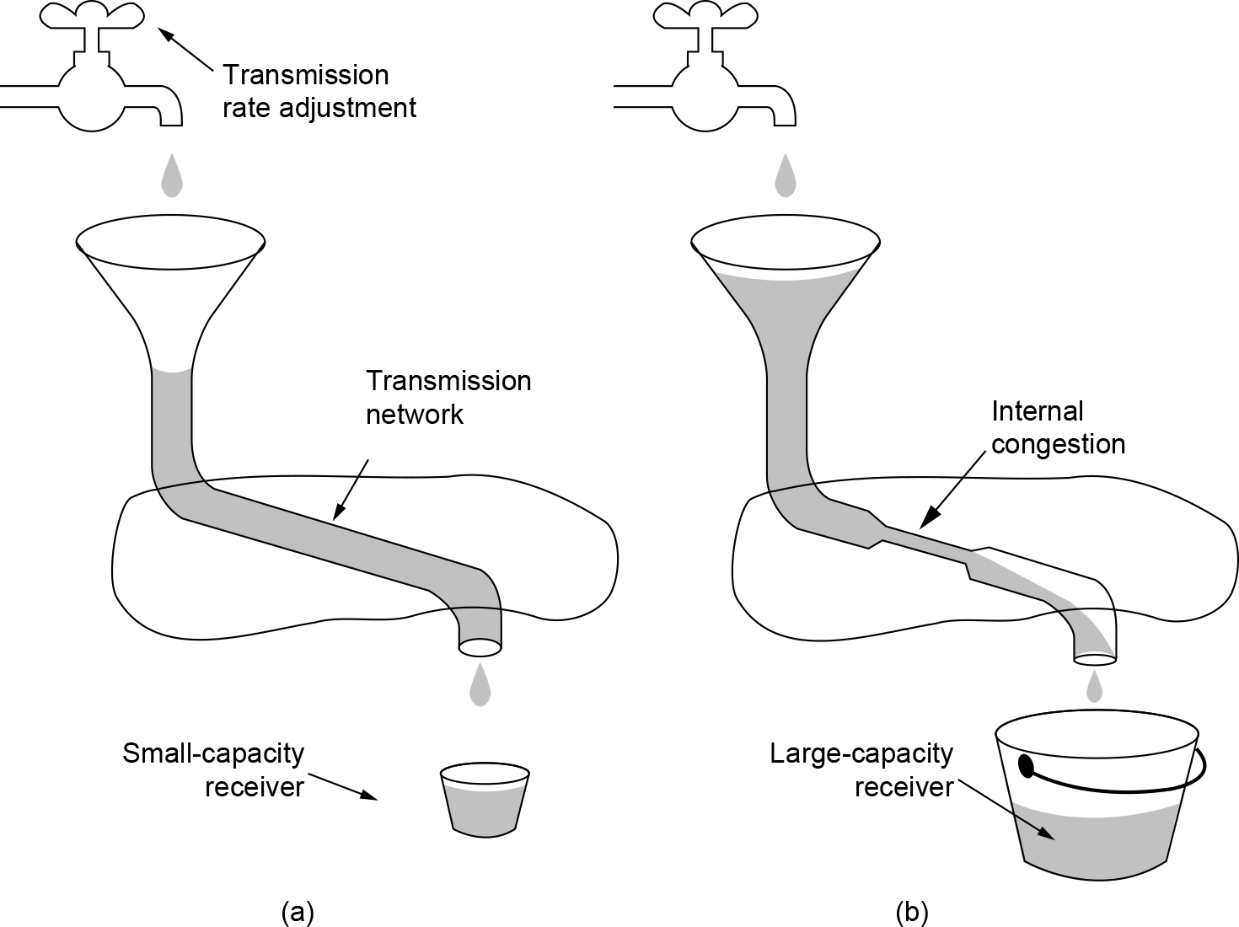
Regulating the Sending Rate (1 of 4)
(a) A fast network feeding a low-capacity receiver. (b) A slow network feeding a high-capacity receiver.

Slide 37
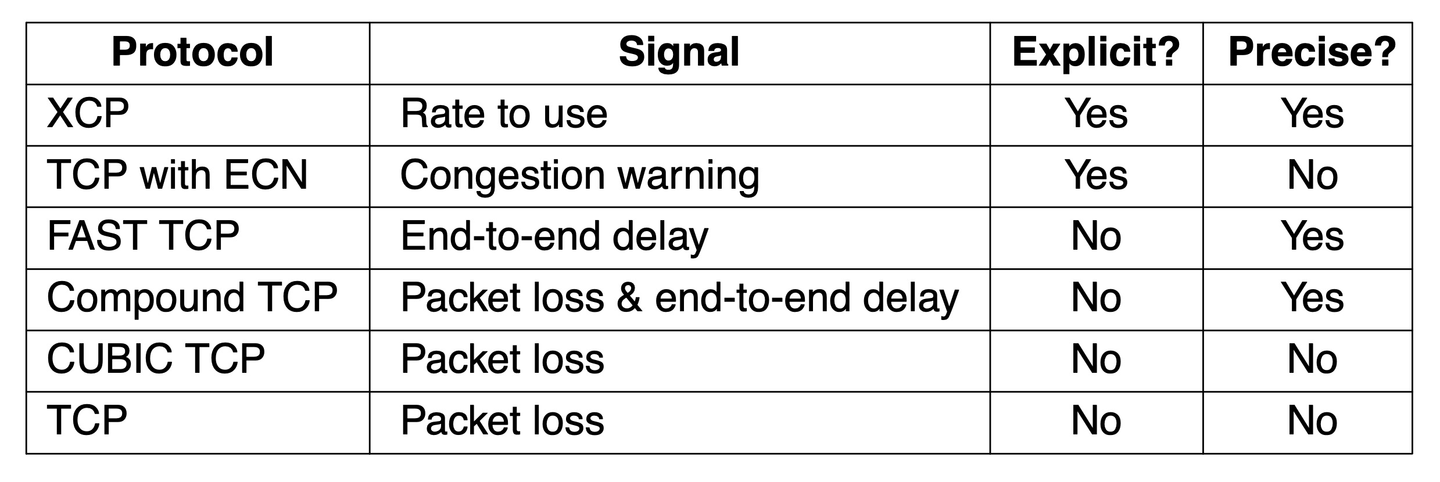
Regulating the Sending Rate (2 of 4)
Signals of some congestion control protocols

Slide 38
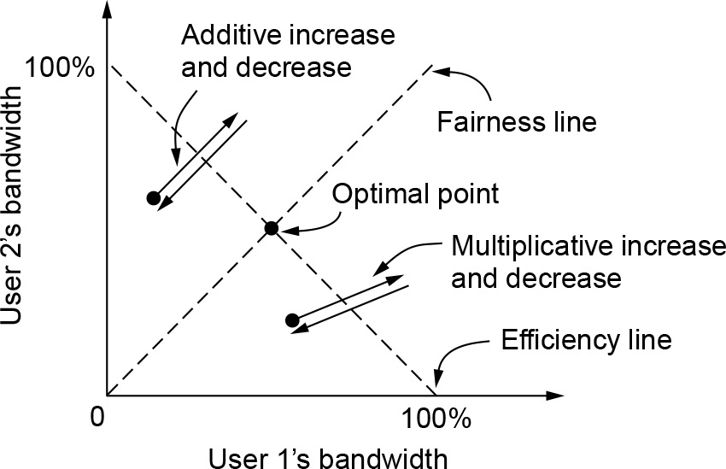
Regulating the Sending Rate (3 of 4)
Additive and multiplicative bandwidth adjustments

Slide 39
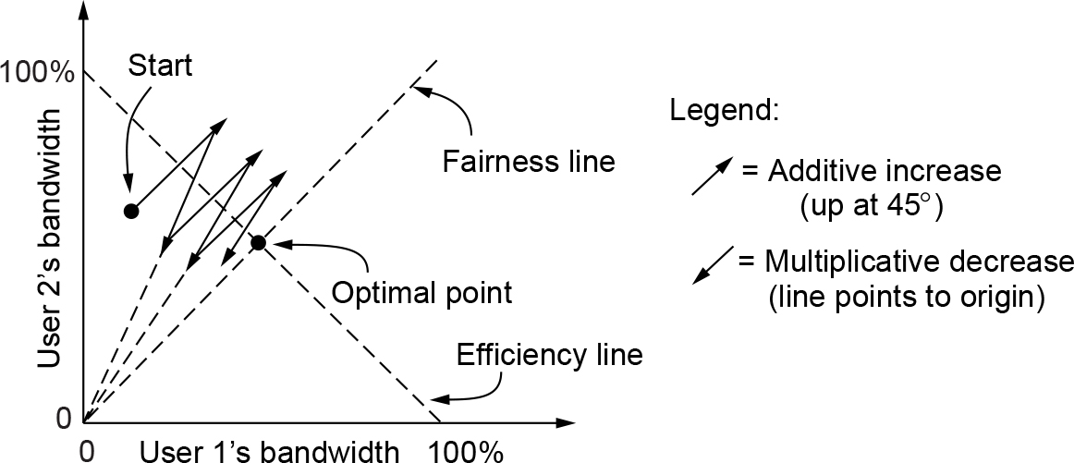
Regulating the Sending Rate (4 of 4)
Additive Increase Multiplicative Decrease (AIMD) control law

Slide 40
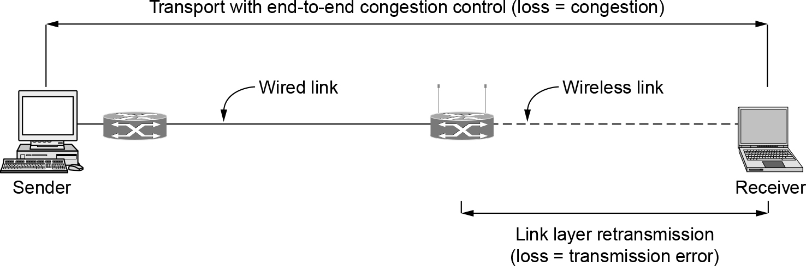
Wireless Issues
Congestion control over a path with a wireless link

Slide 41
The Internet Transport Protocols: UDP
Introduction to UDP
Remote procedure call
Real-time transport
RTP—the Real-time Transport Protocol
RTCP—the Real-time Transport Control Protocol
Playout with buffering and jitter control

Slide 42
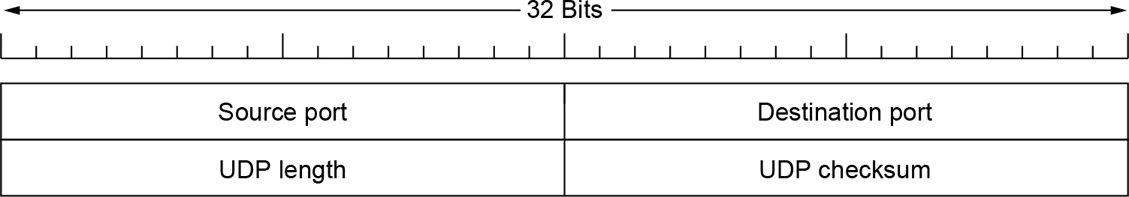
Introduction to UDP (1 of 2)
The UDP header

Slide 43
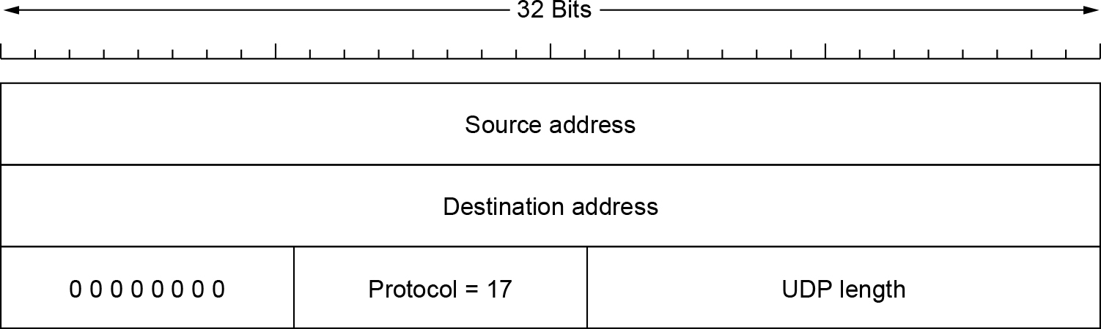
Introduction to UDP (2 of 2)
The IPv4 pseudoheader included in the UDP checksum

Slide 44
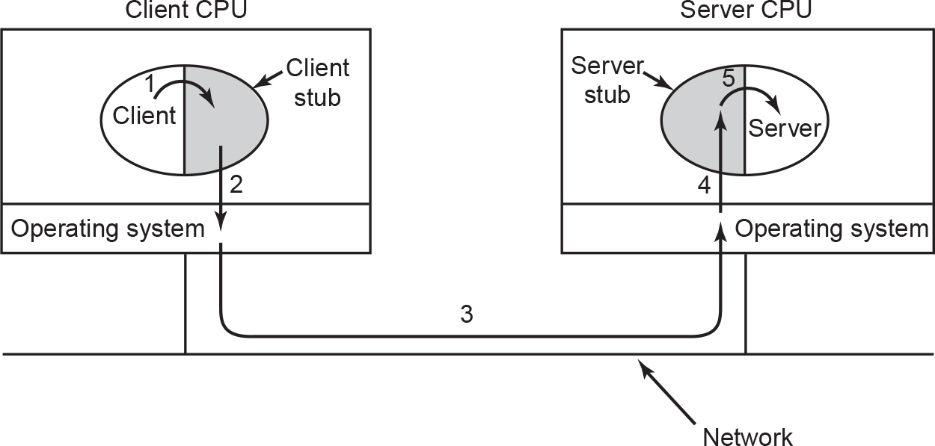
Remote Procedure Call
Steps in making a remote procedure call. The stubs are shaded.

Slide 45
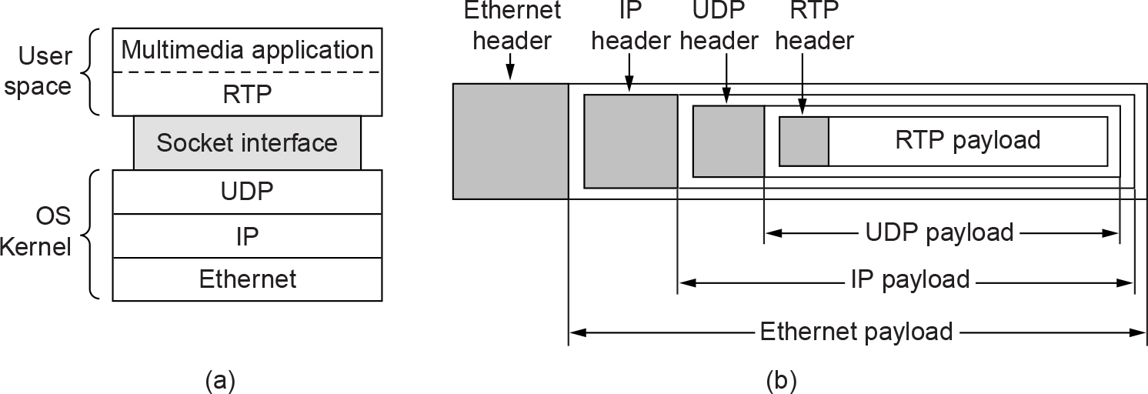
Real-Time Transport Protocols (1 of 4)
(a) The position of RTP in the protocol stack. (b) Packet nesting.

Slide 46
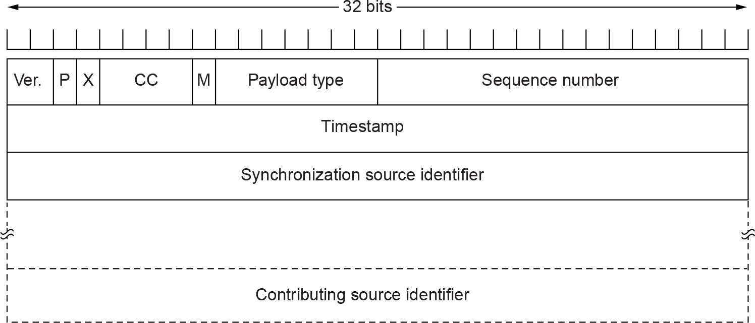
Real-Time Transport Protocols (2 of 4)
The RTP header

Slide 47
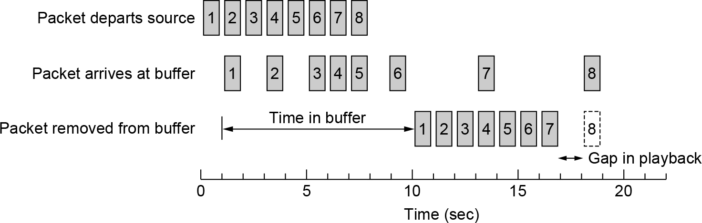
Real-Time Transport Protocols (3 of 4)
Smoothing the output stream by buffering packets

Slide 48
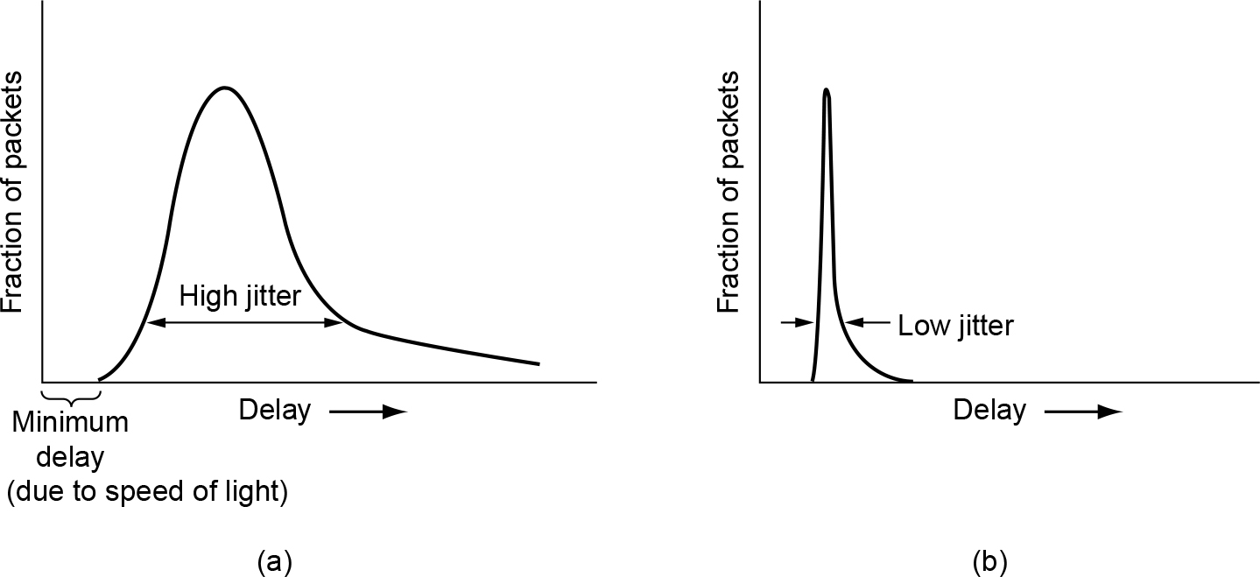
Real-Time Transport Protocols (4 of 4)
(a) High jitter. (b) Low jitter.

Slide 49
The Internet Transport Protocols: TCP (1 of 2)
Introduction to TCP
The TCP service model
The TCP protocol
The TCP segment header
TCP connection establishment
TCP connection release

Slide 50
The Internet Transport Protocols: TCP (2 of 2)
TCP connection management modeling
TCP sliding window
TCP timer management
TCP congestion control
TCP CUBIC

Slide 51
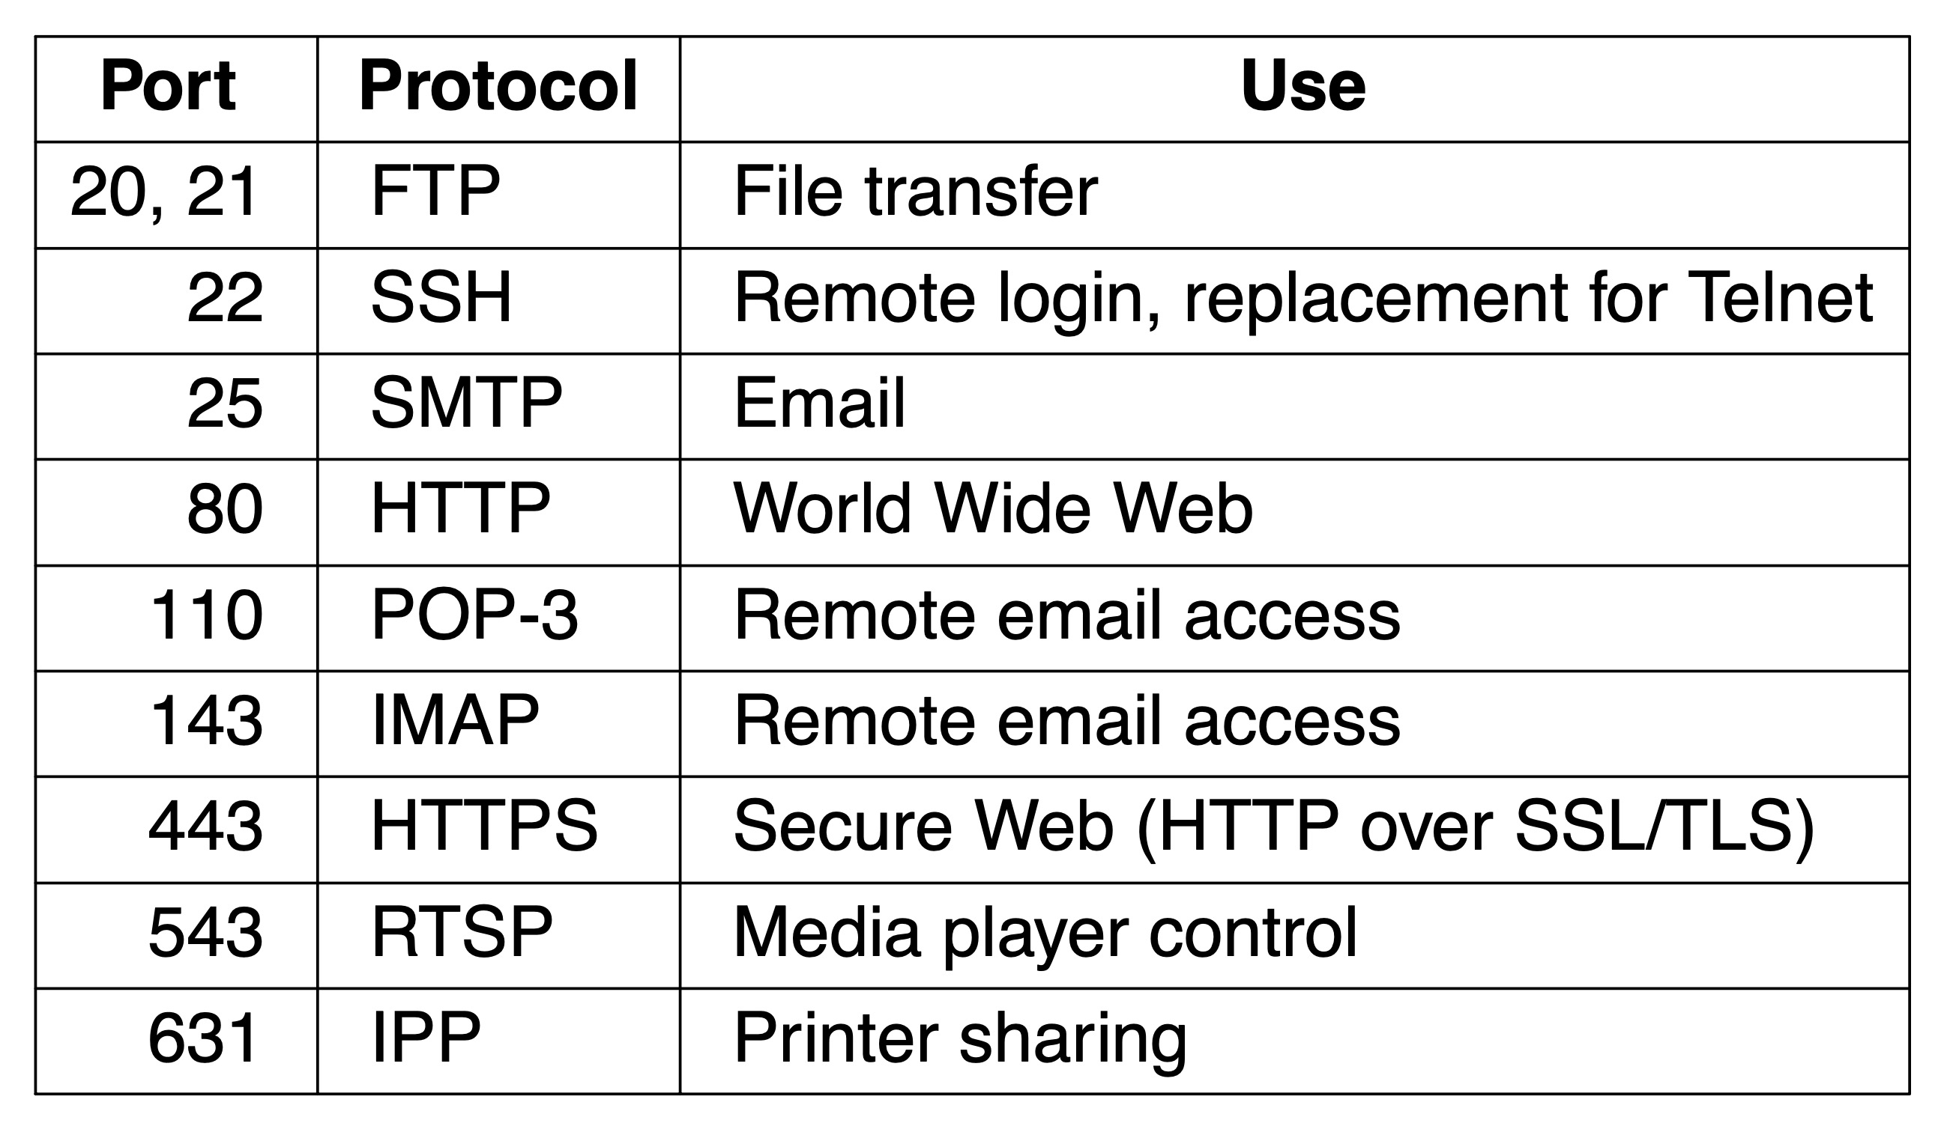
The TCP Service Model (1 of 2)
Some assigned ports

Slide 52
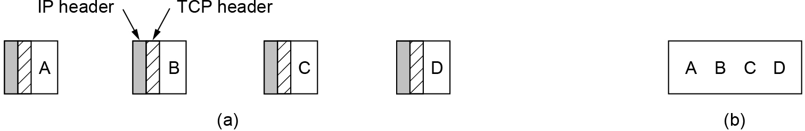
The TCP Service Model (2 of 2)
(a) Four 512-byte segments sent as separate IP datagrams. (b) The 2048 bytes of data delivered to the application in a single READ call.

Slide 53
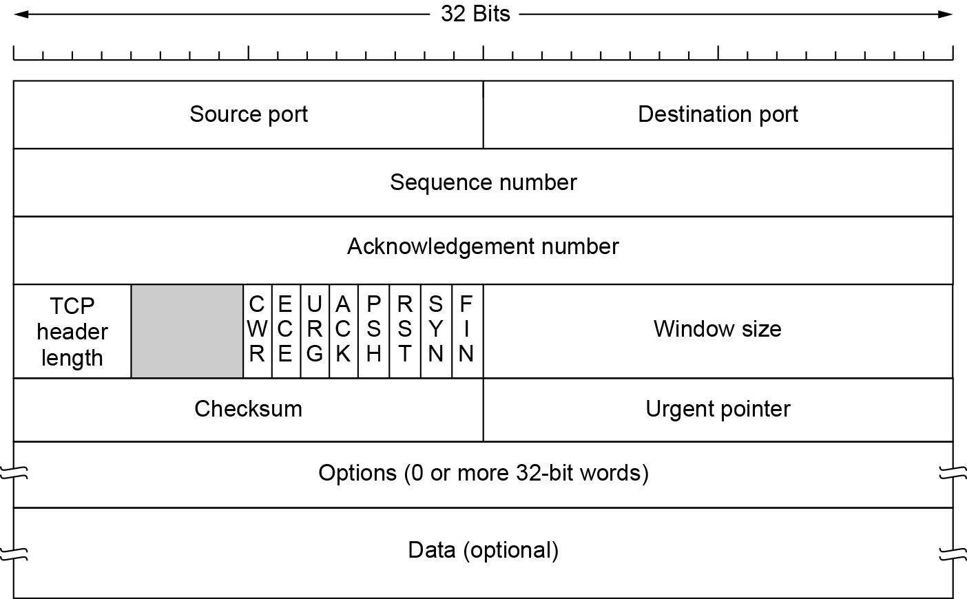
The TCP Segment Header
The TCP header

Slide 54
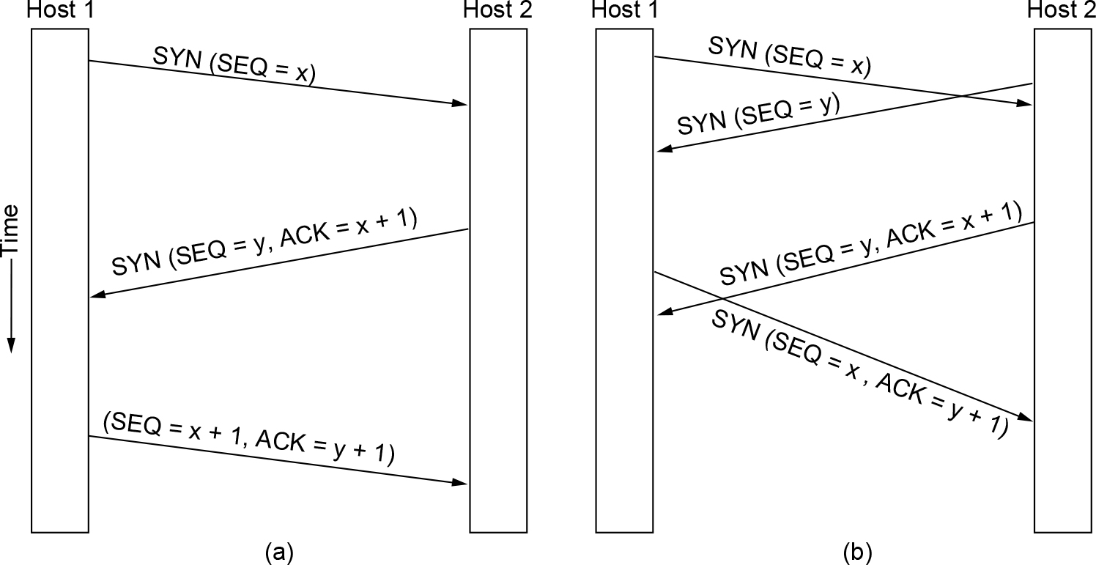
TCP Connection Establishment
(a) TCP connection establishment in the normal case. (b) Simultaneous connection establishment on both sides.

Slide 55
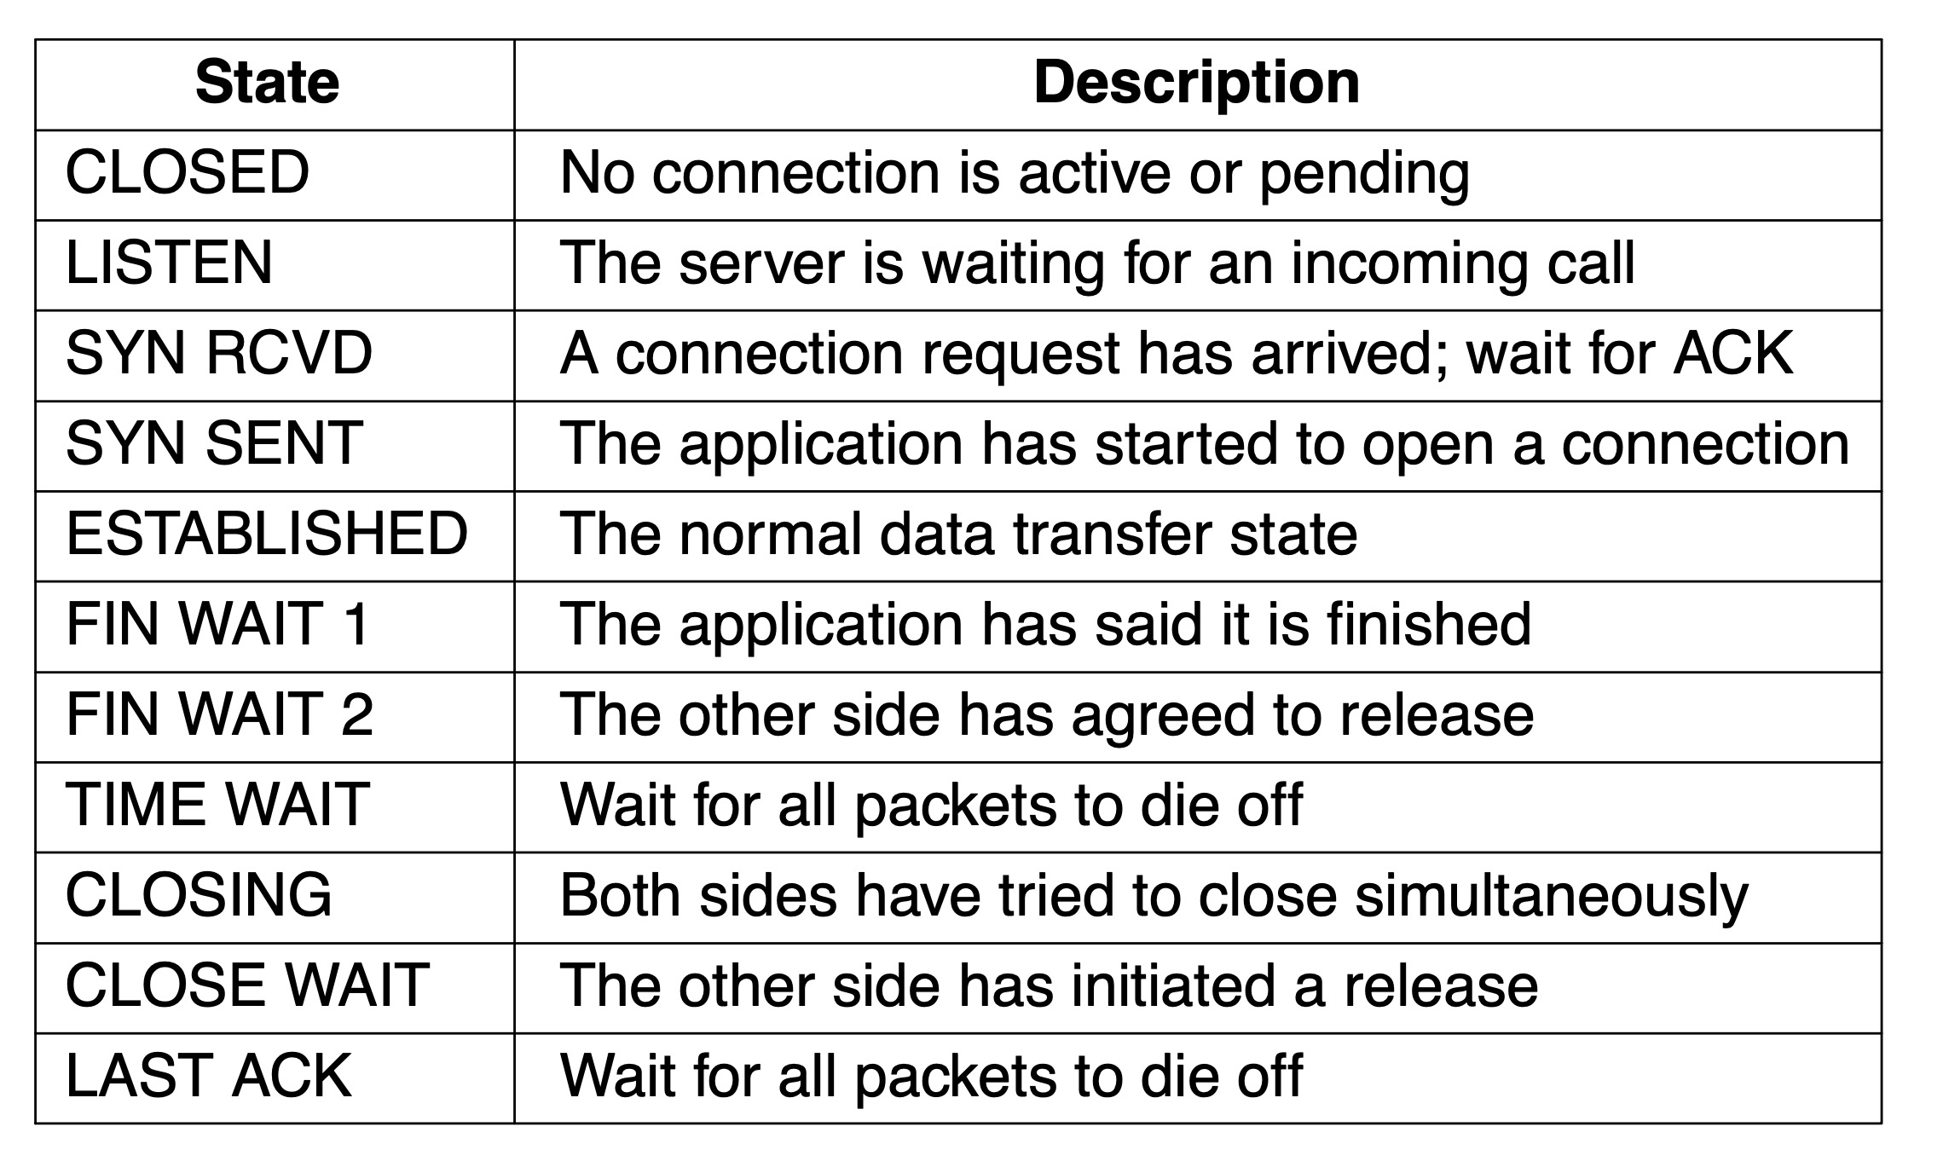
TCP Connection Management Modeling (1 of 2)
The states used in the TCP connection management finite state machine

Slide 56
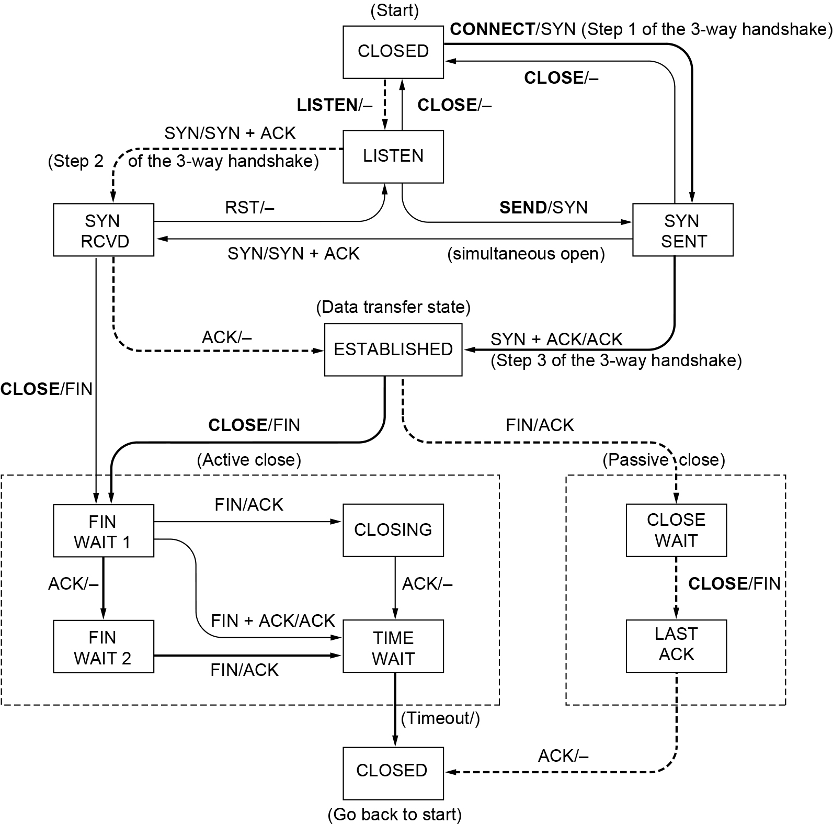
TCP Connection Management Modeling (2 of 2)
TCP connection management finite state machine. The heavy solid line is the normal path for a client. The heavy dashed line is the normal path for a server. The light lines are unusual events. Each transition is labeled with the event causing it and the action resulting from it, separated by a slash.

Slide 57
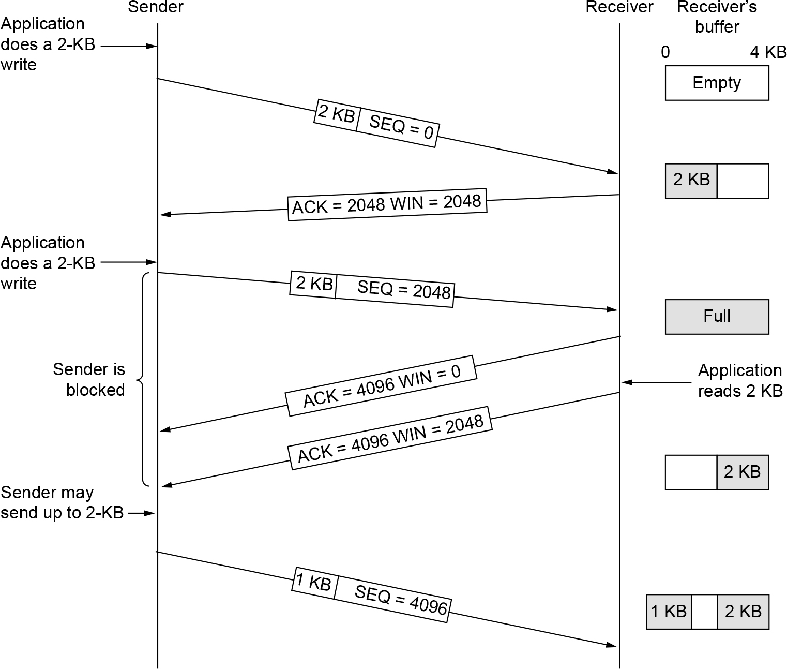
TCP Sliding Window (1 of 2)
Window management in TCP

Slide 58

TCP Sliding Window (2 of 2)
Silly window syndrome

Slide 59

TCP Timer Management
(a) Probability density of acknowledgement arrival times in the data link layer. (b) Probability density of acknowledgement arrival times for TCP.

Slide 60

TCP Congestion Control (1 of 6)
A burst of packets from a sender and the returning ack clock

Slide 61

TCP Congestion Control (2 of 6)
Slow start from an initial congestion window of one segment

Slide 62

TCP Congestion Control (3 of 6)
Additive increase from an initial congestion window of one segment

Slide 63

TCP Congestion Control (4 of 6)
Slow start followed by additive increase in TCP Tahoe

Slide 64

TCP Congestion Control (5 of 6)
Fast recovery and the sawtooth pattern of TCP Reno

Slide 65

TCP Congestion Control (6 of 6)
Selective acknowledgements

Slide 66

TCP CUBIC
Evolution of TCP CUBIC Congestion Window

Slide 67
Transport Protocols and Congestion Control
QUIC: Quick UDP Internet Connections
BBR: Congestion control based on bottleneck bandwidth
The future of TCP

Slide 68

BBR: Congestion Control Based on Bottleneck Bandwidth
BBR Operating Point

Slide 69
The Future of TCP
TCP will continue to evolve
TCP issues
Does not provide transport semantics applications want
Application must deal with problems not solved by TCP
Proposals providing a slightly different interface
SCTP and SST
Must deal with “If it ain’t broke, don’t fix it’’ mentality

Slide 70
Performance Issues
Performance problems
Measuring network performance
Measuring access network throughput
Measuring quality of experience
Host design for fast networks
Fast segment processing
Header compression
Protocols for ‘‘long fat’’ networks

Slide 71
Performance Problems in Computer Networks
Temporary resource overloads
Structural resource imbalance
Synchronous overloads
Broadcast storm from a bad segment
Power returning after power failure
Lack of system tuning
Low buffer space
Setting timeouts
Jitter

Slide 72
Network Performance Measurement
Access network throughput measurement
Run speed test
Measuring link access speed has become more challenging
Filling the pipe requires more data
Under-test client/server bottlenecks move elsewhere in the network
Speed is less relevant to network performance
Quality of experience or application performance more important

Slide 73
Measuring Access Network Throughput
Best practices
Use multiple parallel TCP connections to fill the capacity of the access link
Perform access network throughput tests directly from the home router
Measure multiple Internet destinations in parallel from a single access connection
Develop ‘‘passive’’ throughput tests

Slide 74
Measuring Quality of Experience
Modern network performance measurement
Moving beyond simple speed tests
Typically based on passive observation of network traffic
User’s quality of experience
Measures person’s happiness with a service
A human consideration
Might require human feedback
Future technique
Automatic estimation of user quality of experience
Based on passive measurement of features in network traffic

Slide 75
Host Design for Fast Networks
Host speed is more important than network speed
Reduce packet count to reduce overhead
Minimize data touching
Minimize context switches
Avoiding congestion is better than recovering from it
Avoid timeouts

Slide 76

Minimize Context Switches
Four context switches to handle one packet with a user-space network manager

Slide 77

Fast Segment Processing (1 of 3)
The fast path from sender to receiver is shown with a heavy line. The processing steps on this path are shaded.

Slide 78

Fast Segment Processing (2 of 3)
(a) TCP header. (b) IP header. In both cases, they are taken from the prototype without change.

Slide 79

Fast Segment Processing (3 of 3)
A timing wheel

Slide 80

Protocols for Long Fat Networks (1 of 2)
The state of transmitting 1 Mbit from San Diego to Boston. (a) At t = 0. (b) After 500 µsec. (c) After 20 msec. (d) After 40 msec.

Slide 81

Protocols for Long Fat Networks (2 of 2)
Time to transfer and acknowledge a 1-Mbit file over a 4000-km line

Slide 82

Copyright
This work is protected by United States copyright laws and is provided solely for the use of instructors in teaching their courses and assessing student learning. Dissemination or sale of any part of this work (including on the World Wide Web) will destroy the integrity of the work and is not permitted. The work and materials from it should never be made available to students except by instructors using the accompanying text in their classes. All recipients of this work are expected to abide by these restrictions and to honor the intended pedagogical purposes and the needs of other instructors who rely on these materials.

